Slide 1
Incorporating digital forensics capability into Our access Portfolio
Team Members:
Vignesh Balakrishnan
Manish Jaiswal
Michael Rennie
Ranjeet Mani
Team Name : Cyber Knights
CATEGORY : Remote Access & Management
Location : Bangalore
Date : 13th Oct, 2017

Slide 2



The Problem
Multiple products for IT infrastructure management and Endpoint Security

Slide 3
Market size
711mn devices
40mn devices
$2.28bn by 2021
CAGR of 25%
$749mn in 2016
**Reports based on Gartner and PRNewswire

Slide 4
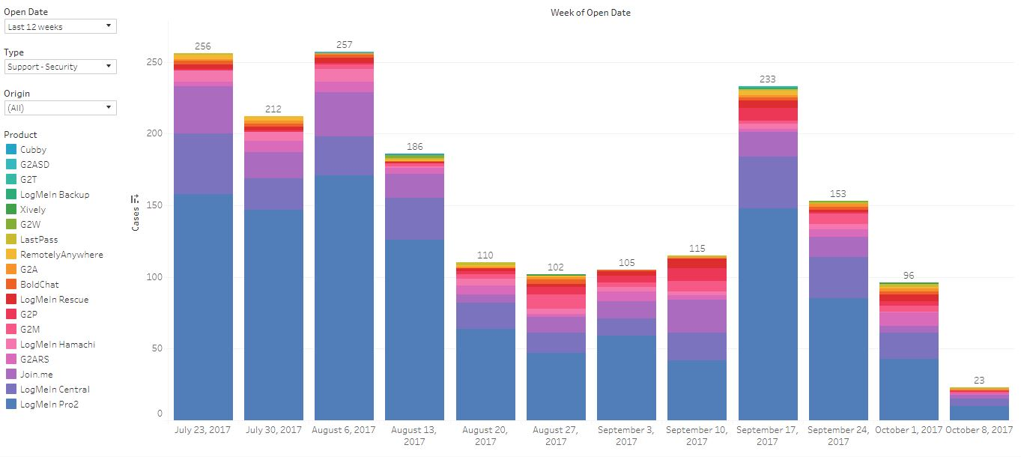
Customer Validation Data points from our customer care team for incidents related to security

Slide 5
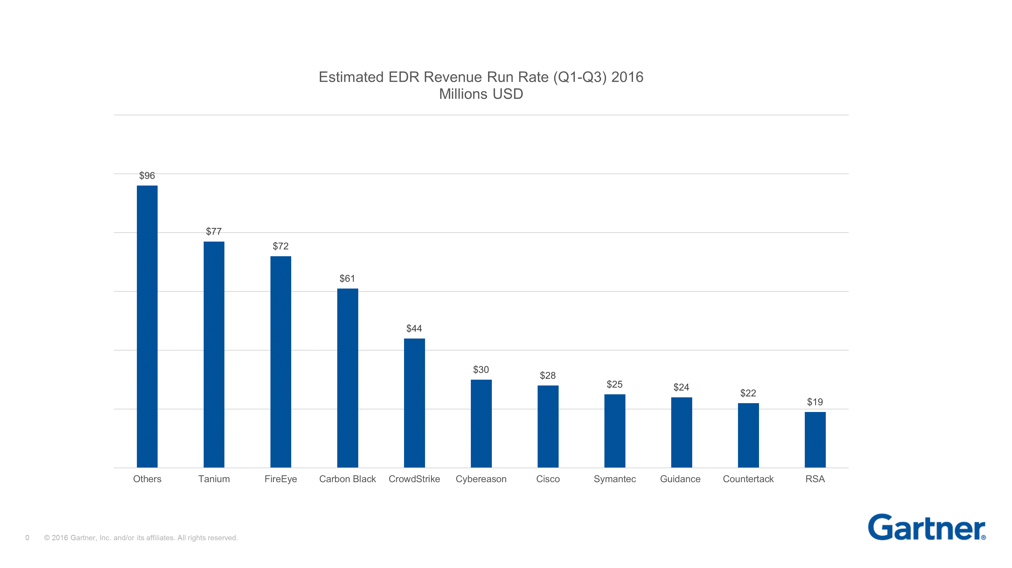
Competitor landscape

Slide 6



The Solution/Benefit to Customers
An online tool, integrated with CentralPro/Rescue for users to gain fast, in-depth visibility into their network
Reducing the need for multiple security software
Single agent monitoring
Respond to alerts, identify & analyze

Slide 7
Competitive advantage
Bundled packaging
Reduced expenditure
Reduced manual process and controls

Slide 8
Product DEMO…

Slide 9
OUR BUSINESS MODEL – THANK YOU!!!
PROBLEM | SOLUTION | UNIQUE VALUE PROPOSITION | UNFAIR ADVANTAGE | CUSTOMER SEGMENTS
Multiple products for IT infrastructure management with a lack of Endpoint Security focus results in Increase in cost Operational overhead Complex solutions requires skilled resource | Integrate basic Endpoint Detection and Response [EDR] capability into our Access Portfolio Single agent Simplify detection and response Mitigate possible risk and adhere compliance | Single Product with centralized view to manage IT infrastructure and equip security teams/ IT admins with Endpoint detection, analysis and response capabilities | An integrated solution that supports the needs of multiple stakeholders (IT, Security Team, Customer Care) | Organizations who do not have a dedicated security team Security Operations and IT infrastructure team SMB who need simple, effective and cost efficient solution
EXISTING ALTERNATIVES | KEY METRICS | CHANNELS | EARLY ADOPTERS
Expensive Commercial EDR Products [ FireEye, Carbon Black, Tanium , Crowd Strike, etc.] | No of agents deployed Revenue per customer | Marketing and Advertisement Webinars and Conference | Existing CentralPro and Rescue Customers
COST STRUCTURE | REVENUE STREAMS
Resources to research and develop Endpoint Detection and Response [EDR] capability Hosting infrastructure Acquisition cost | Agent based licensing per endpoint Subscription model

Slide 10
Appendix
https://india.emc.com/security/rsa-ecat.htm#!resources - resources
https://india.emc.com/collateral/analyst-reports/esg-rethinking-endpoint-security.pdf - report ESG
https://india.emc.com/collateral/customer-profiles/h11832-emc-ecat-cp.pdf - RSA use-case
http://blogs.gartner.com/avivah-litan/2017/03/15/morphing-edr-market-grows-to-1-5-billion-in-2020/ - growth
https://www.sans.org/reading-room/whitepapers/analyst/security-spending-trends-36697 - expenses
http://www.prnewswire.com/news-releases/endpoint-detection-and-response-edr-market-to-grow-at-a-cagr-of-25-by-2021-increasing-instances-of-enterprise-endpoint-targeted-attacks---research-and-markets-300405030.html - prnewswire

Slide 11
Appendix(Contd) DIFFERENCE BETWEEN current CENTRALPRO FEATURES vs PROPOSED ONE
CURRENT
PROPOSED
Patch Management
Anti virus Protection
Anti Malware Protection
Proactive Alerts
End Point Monitoring
Audit & Inventory
Mobile Access
Complete Endpoint visibility
Evidence of execution
Persistence Mechanism
Lateral Movement
Gather Forensic Evidence
Search across network for Indicators of Compromise (IoC)
Browser Artifacts
Overview of System

Slide 12
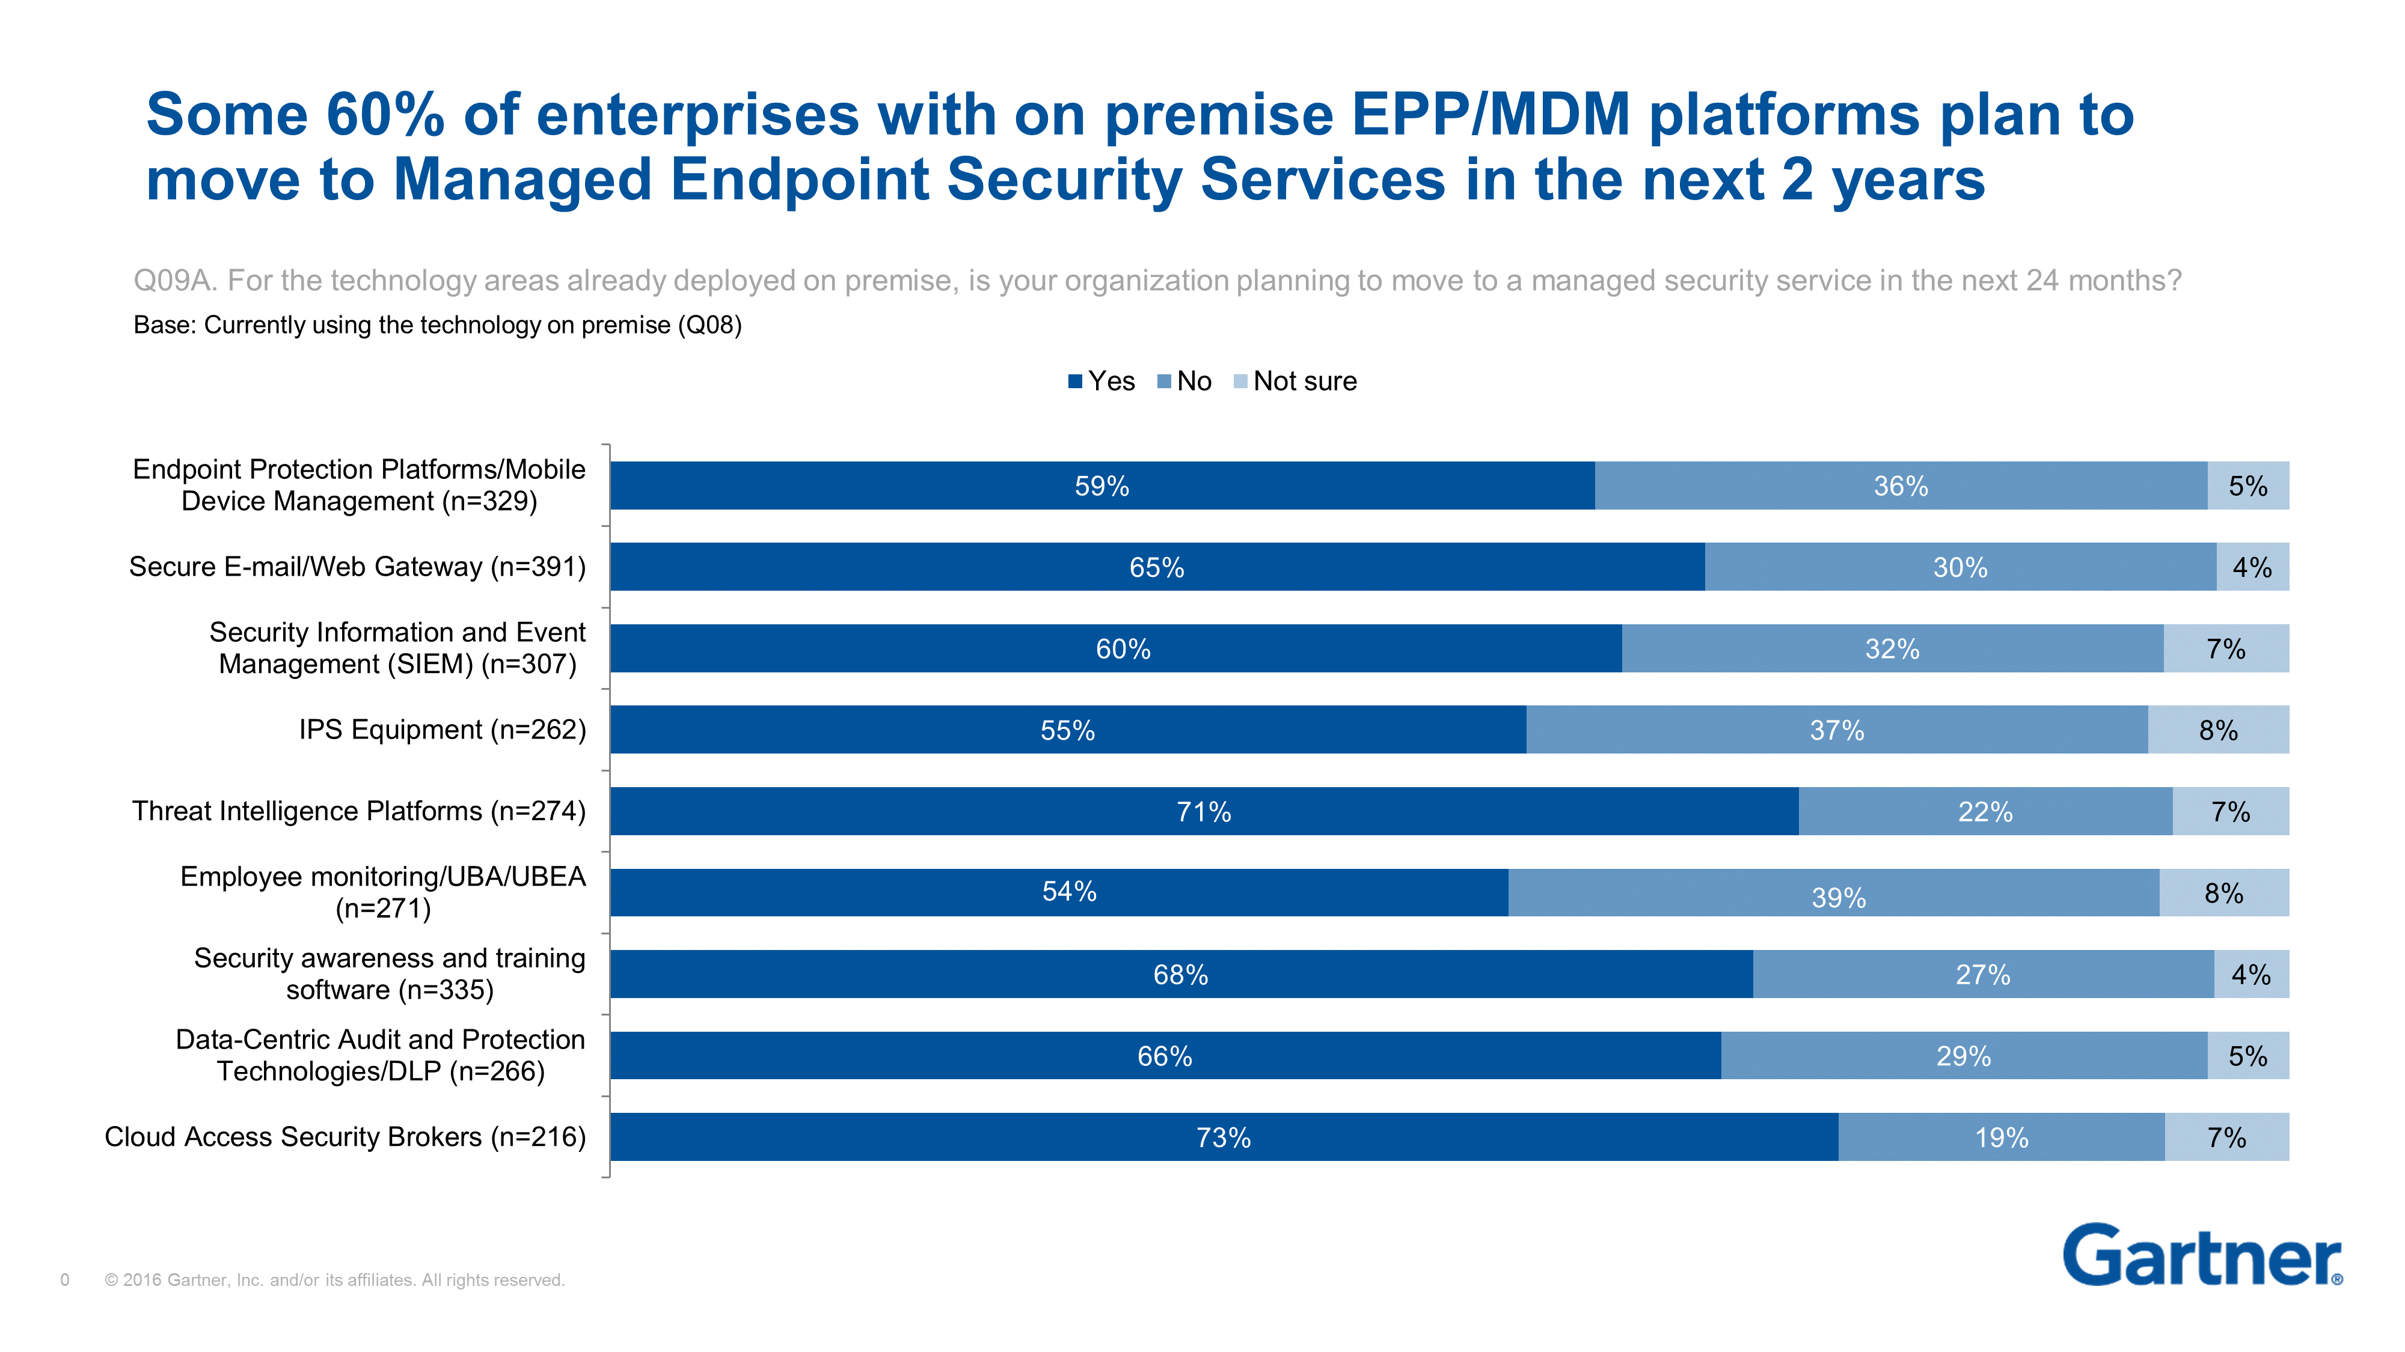
Appendix(Contd)

